Slide 1
Regional Operations Model Agenda (ROMA) 2024 Plan

Slide 2
Redefining FiberOne
Working Ecosystem -
People, Process &
Performance for
Balanced Growth

Slide 3
Table of Contents
Executive Summary
Organogram/Teams
Vision, Mission & Values
Ethos and Guiding Principle
Focus Areas of Excellence
Conclusion

Slide 4
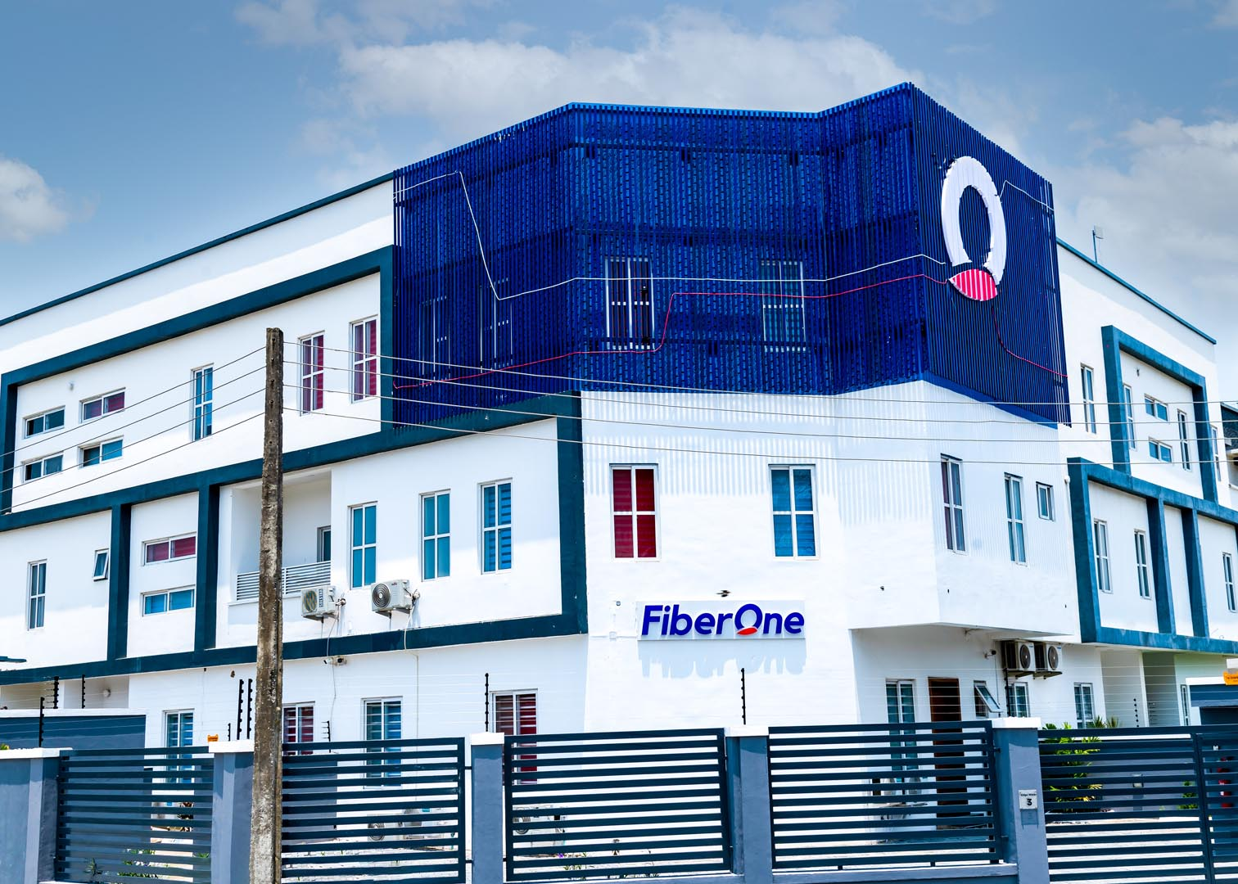
Executive Summary
Corporate Services Department is pleased to present this ROMA 2024 Plan, outlining our vision, mission, values, ethos, GP, and focus areas, for the year 2024. As we navigate an ever-evolving business landscape, this agenda serves as a roadmap to guide the regional operations in delivering the organization’s objectives and KPIs for balanced growth and long-term success.
The ROMA 2024 seeks to build on the successes gained and the knowledge garnered in the past few years which has allowed for baselines to be established for several of our operational activities.
These baselines have allowed the Management Team to identify and acknowledge operational weaknesses and determine how best to treat and actualize opportunities where possible. In the last few years, we have sought to rework the operations as a means of delivering both the top line and bottom line of FiberOne and will now seek to compliment this push with greater focus on its PEOPLE, PROCESS (internal operating procedures and practices) and PERFORMANCE enabling greater resilience to change, agile workforce, high performance culture, process efficiency, motivated employees and a balanced growth (i.e., growth that is profitable, sustainable, and capital efficient).

Slide 5
Regional Org. Structure
CCO/CTO/CXO
Regional Manager -1
Regional Manager -2
Regional Manager UC
Manager, SD
Manager, CRM/Retention
Area Sales Manager/Regional Coordinator/CRM Regional Lead (Mainland)
Area Sales Manager/Regional Coordinator/CRM Regional Lead (Upcountry)
Area Coordinators/Cluster Sales Executives
Area Sales Manager/Regional Coordinator/CRM Regional Lead (Island)
Area Coordinators/Cluster Sales Executives
Area Coordinators/Cluster Sales Executives

Slide 6
Our Vision
To reinvent the future by creating access to the possibilities inherent in the world with the internet.
Integrity
Innovation
Our Mission
To inspire innovation by providing unlimited possibilities to all that come across our brand.
Quality
PwC

Slide 7



fa
Ethos
Fast:- Speed matters. We set clear direction and move fast. Learn quickly and share learnings. We focus on outcomes.
Bold:- Dream big – with innovative ideas. Make tough decisions quickly and proudly stand accountable for them. Resilient and fearless to beat the competition
Responsive:- We take deliberate actions to reduce ‘noise’ in whatever form or shape from both internal and external customers
Empathy:- We will be therapeutically attuned and passionate everything customer
Resourceful:- We will be effective and efficient. We will provide tools that will facilitate value creation practices.
Empowered:- we have to trust the skills, experience and knowledge of the workforce. Challenge each other. Once in agreement, we commit collectively and hold each other accountable to deliver
Fast
Empowered
Bold
Ethos
Resourceful
Responsive
Empathy

Slide 8
Our Guiding Principle
CUSTOMER
OBSESSED

Slide 9
Focus Areas of Excellence
PEOPLE
High Performance Culture
Leadership | Ethos & Guiding Principle | Objectives
Strong Financial Performance
100% Compliance
PROCESS
Future State
Operational Excellence
Effective Communication and Collaboration | Documentation, Data, and Reporting | Efficiency
Work-Life Harmony
Culture Transformation
Clean Data & Reporting
PERFORMANCE
Performance KPIs | Results | Reward
Agile Workforce

Slide 10


